Slide 1

Forecasting of Gold Prices

Slide 2
My team :
Mr. Yogesh Bhosale
Mr. Siddhesh Mestry
Mr. Akshay Maskar
Mr. Nikhil Jagdale
Mr. Aditya Wargantiwar
Mr. Ankit Modak

Slide 3
Objectives :
1. To understand the structure of the dataset.
2. To build a suitable model for time series analysis.
3. To predict data for next `30` days with maximum accuracy.

Slide 4
Timeline
Data understanding & EDA
Understanding what’s in the dataset. Preprocessing the data.
Stationarity
To check if the data is stationary or not. If not, making the data stationary.
Model building
Trying to build a suitable model for forecasting time series gold price data.
Experimentation
Hyper-paramters tuning and finding model with best fit.
Deployment
Deploying the best fit model on GitHub.

Slide 5
About dataset :
The dataset is provided by ExcelR institute.
The dataset consist of 2 columns and 2184 rows:
Column names: * Date
* Price

Slide 6
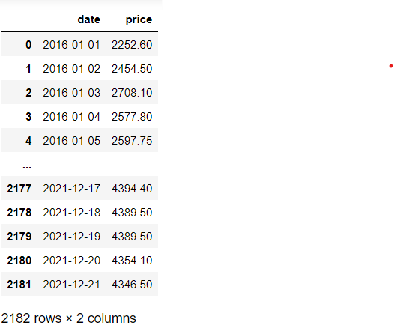
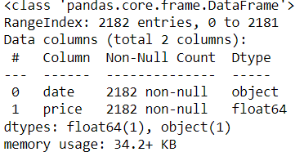
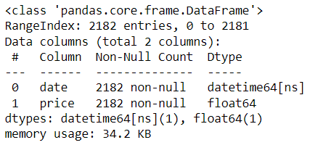



Data :
To datetime dtype conversion :

Slide 7
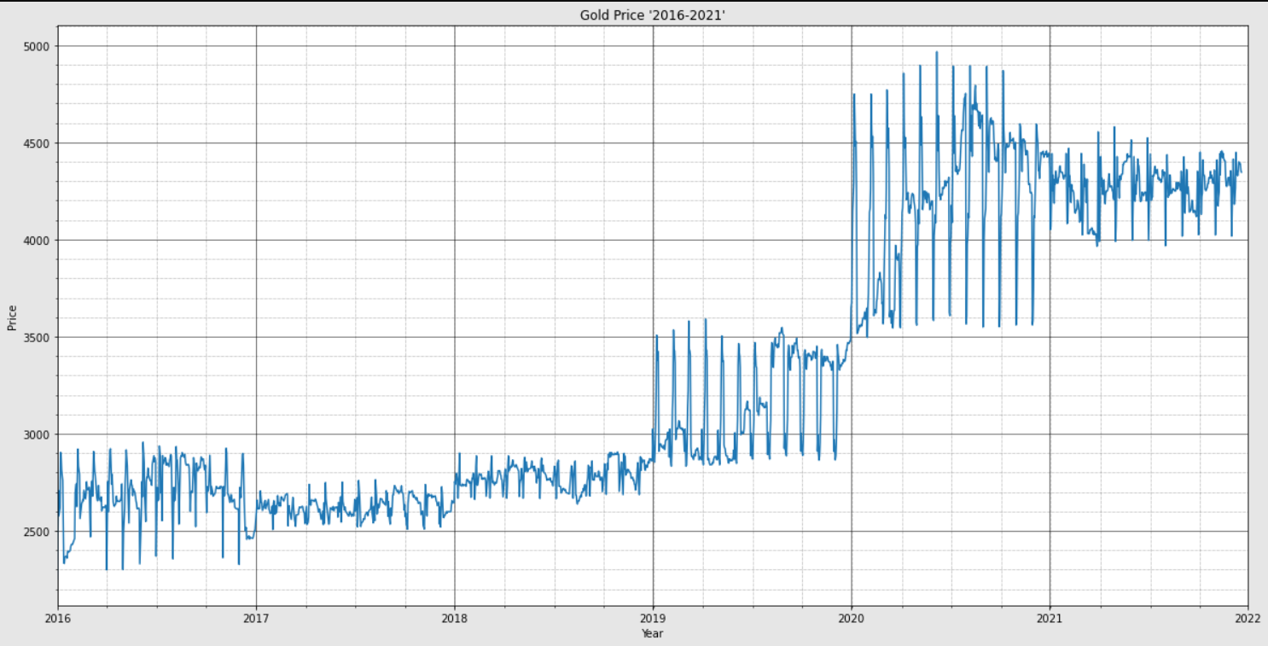
Exploratory data analysis (EDA)

Slide 8
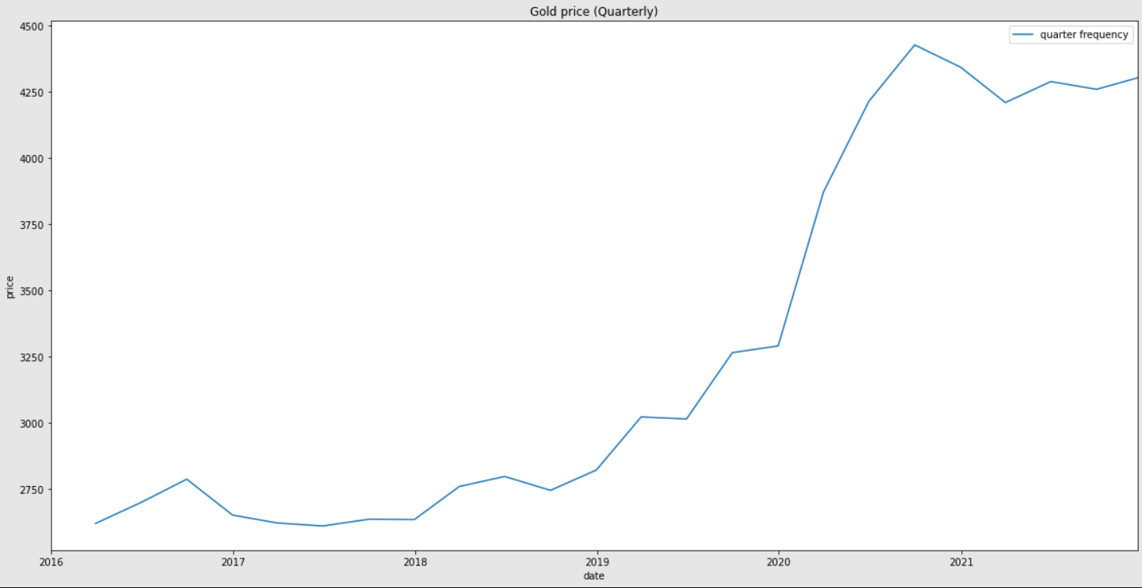
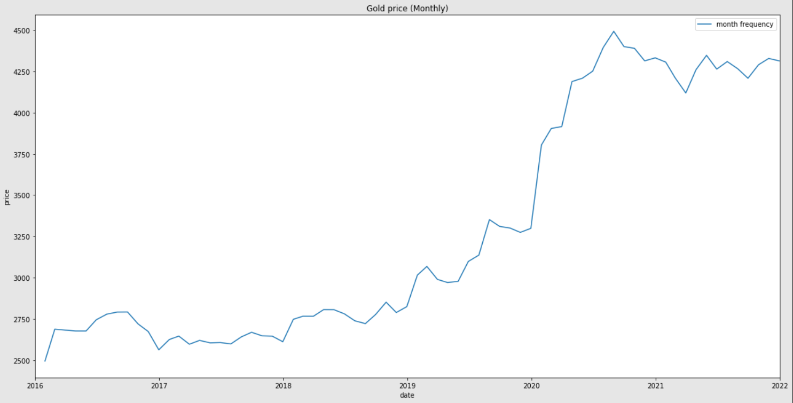
Quarterly Lineplot for Prices
Monthly Lineplot for Prices

Slide 9
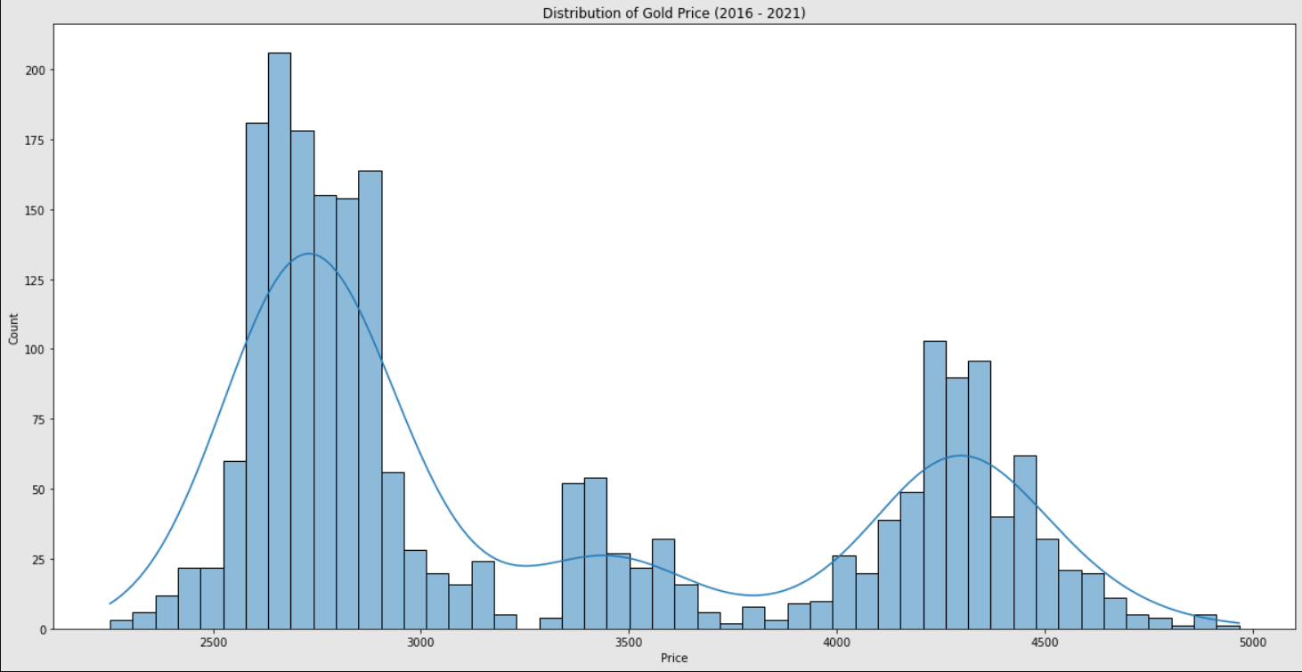
Distribution of Gold Prices :

Slide 10
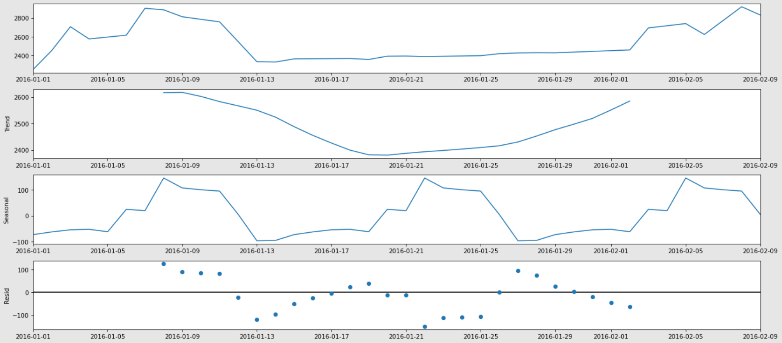
Seasonality And Trend :

Slide 11
Takeaways :
Lineplot & Histogram & Seasonal decompose
The data follows an increasing trend over the period of years.
Data has monthly, quarterly, yearly as well as 2 week seasonality.
The prices mostly lie between 2500-3000 and 4000-4700.
The prices fluctuates more in year 2020.
We can see a sharp increase in the prices after year 2020.

Slide 12
Stationarity
Using augmented dickey fuller test (adf)
Hypothesis :
Rejection criteria :
H0 : The data is non-stationary.
H1 : The data is stationary.
Reject H0 if p < 0.05
Note : When the data is stationary, the data does not have a time dependent structure. This does not mean that the data will not change over time. This means that, the statistical properties of the process generating time series will not change over time.

Slide 13
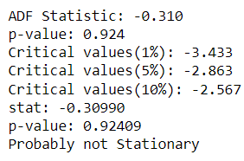

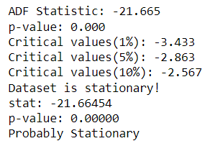
Check and Differencing :
Before differencing :
After differencing :

Slide 14
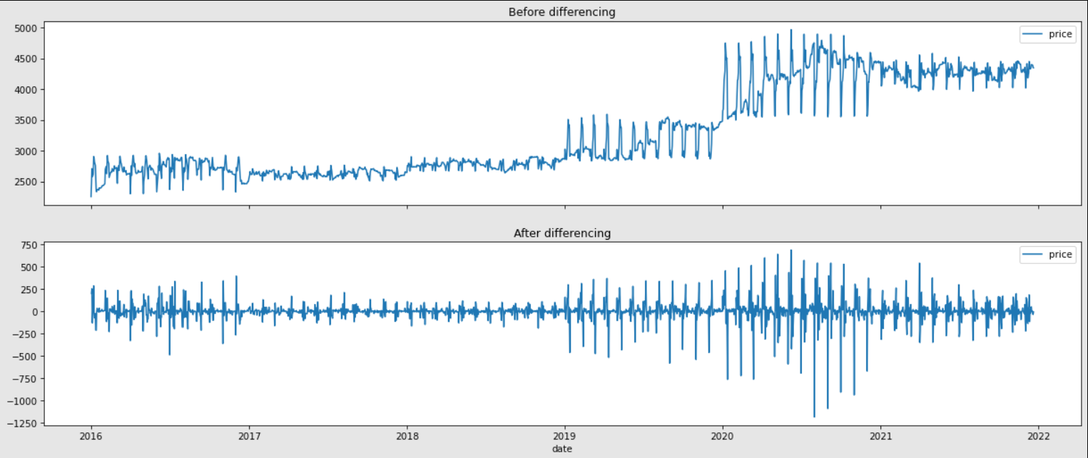
Lineplot before and after differencing the data :

Slide 15
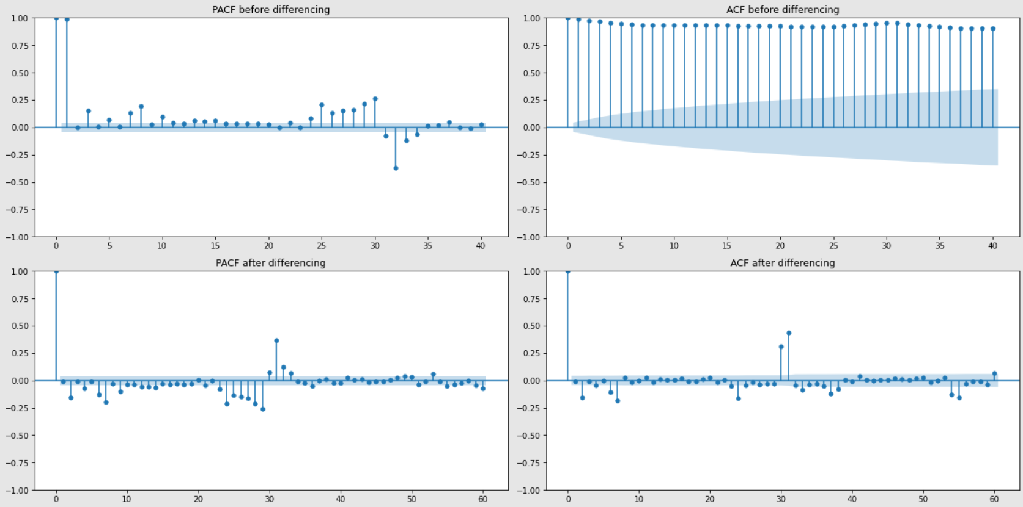
To build ARIMA model we first need to check ACF and PACF plots to decide the significant values pf `p` and `q`
By above plots, we can conclude to take :
p = 2, 4, 6, 7
q = 2, 6, 7

Slide 16
Train and Test Split :
We split the whole data into 8:2 ratio.
80% of the goes to Train split.
20% of the data goes to Test split.

Slide 17
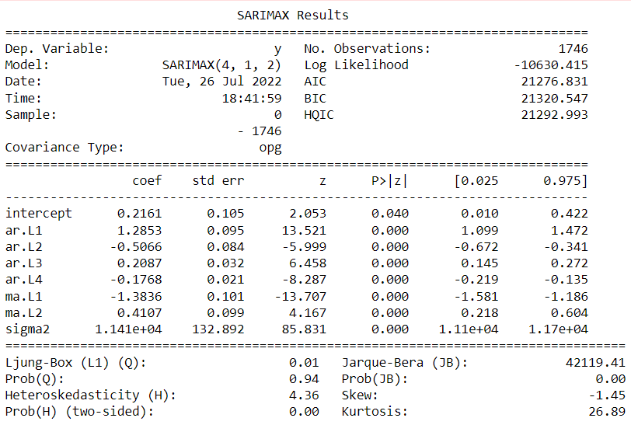

Model Building and Experimentation :
Auto-arima
We used auto-arima model to determine order for arima model with least AIC score.
We found that model with order : (4, 1, 2) gave least AIC.
We trained arima model with order : (4, 1, 2) on the training data.

Slide 18
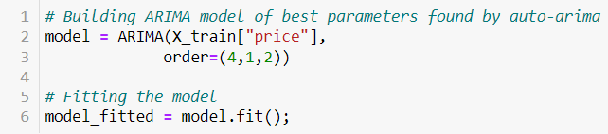
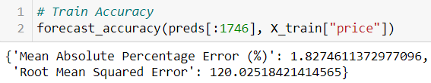
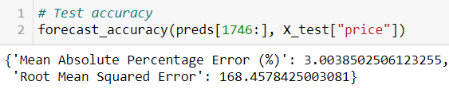
ARIMA :
From the best model given by auto-arima, we trained the arima model.
We made the predictions on both train and test data and calculated Mean absolute percent error.
We tried to plot the test train and predictions using lineplot.

Slide 19
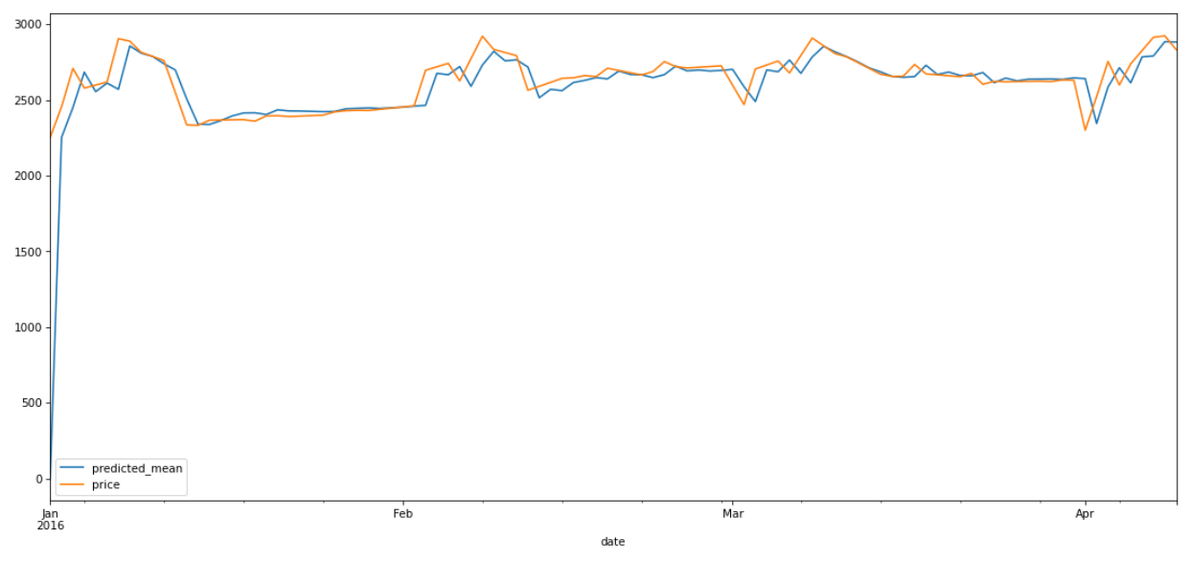
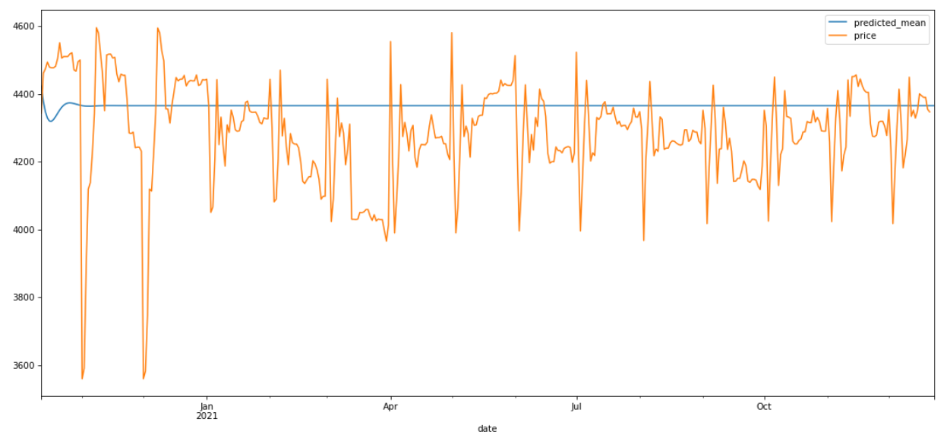
Train vs Predictions :
Test vs Predictions :

Slide 20
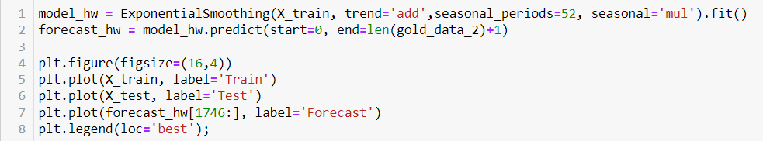
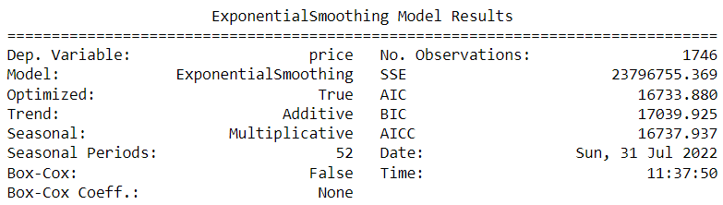
Holt Winters :
Tried to fit Holt-winters model to the training data.
We made predictions on both train and test data to calculate Mean absolute percent error.
We plotted test train and predictions with the help of lineplot.

Slide 21
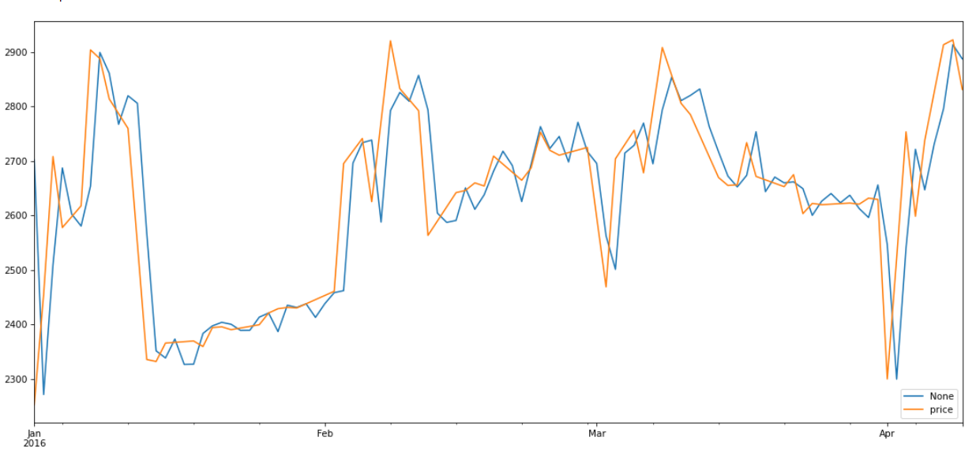
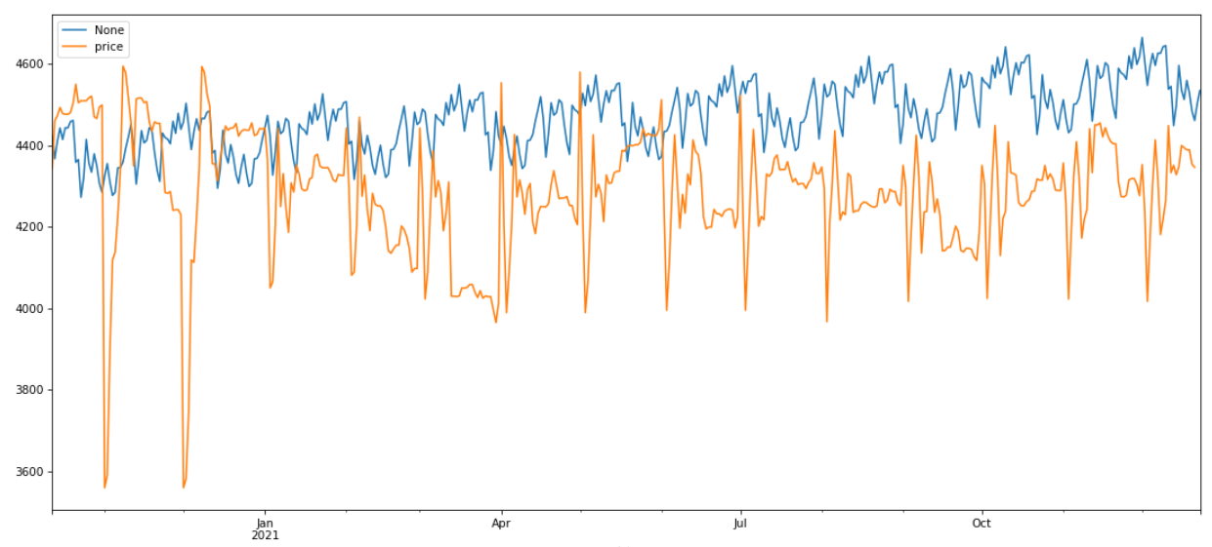
Train vs Prediction :
Test vs Prediction :

Slide 22
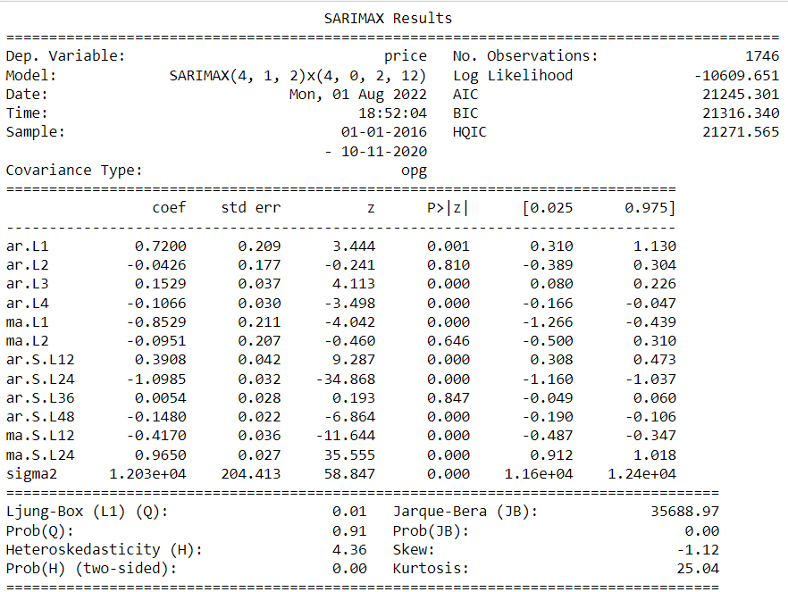
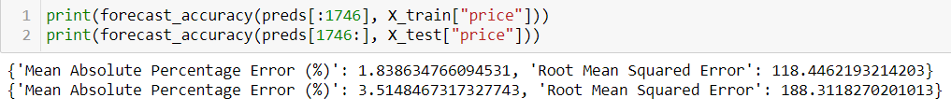
SARIMAX
Sarima
We tried multiple orders and seasonal orders. We found best fit with order – (4,1,2) & seasonal order – (4,0,2,12)
We fitted the model and predicted the gold prices.
We could see that the model was better at predicting train and test data as compared to ARIMA and Holt-winters.

Slide 23
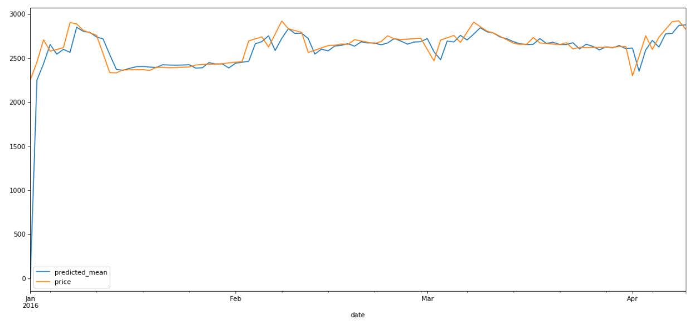
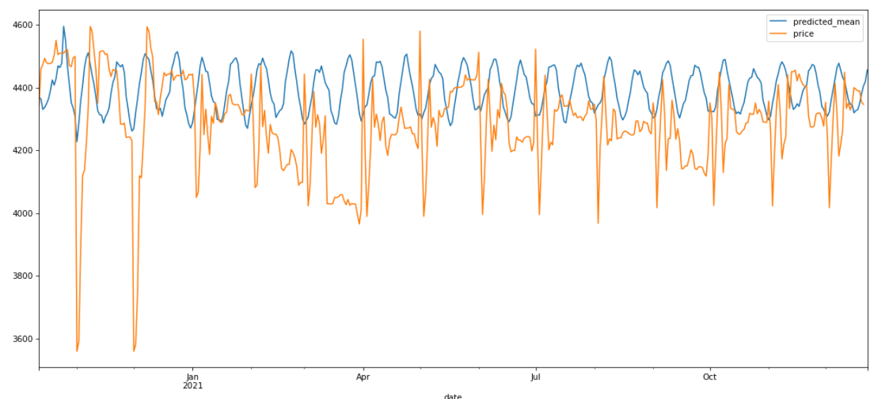
Train vs Predictions :
Test vs Predictions :

Slide 24

Deployment :
pickle
App.py
Requirements.txt
Using pickle.dump we saved the trained and fitted sarima model.
Made an App.py file to deploy the app on GitHub using streamlit.
We can choose number of days we want to predict and the app will give predictions.
This text files contain the modules we used to deploy and train the model.
All the names with versions (if required) of the modules we used are given in this file.

Slide 25
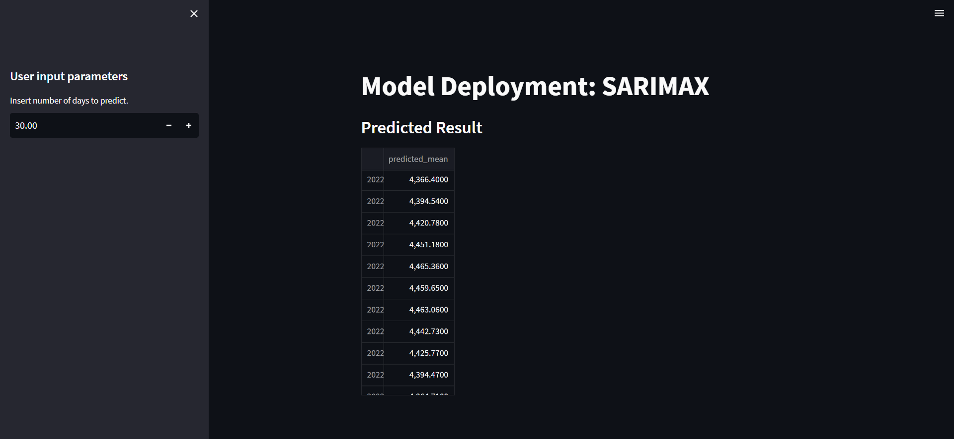
Deployment :

Slide 26

Thank you

